Slide 1
Sprocket Central Pty Ltd
Data Visualization
Chisom Ibezim

Slide 2
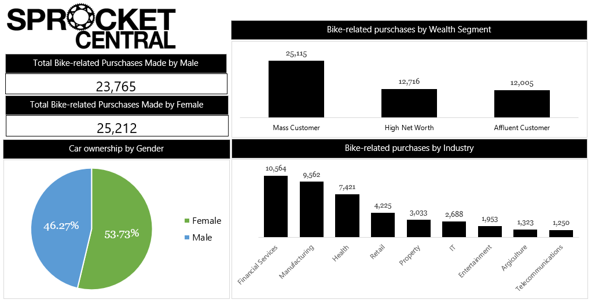
Data Dashboard

